Slide 1
Encrypt-o-File
Zain Husain
Aaron Stone
Brad Mickow
Bryan Nejad
Robbie Castillo
Wes Bales
Nooreen Ahmad
Notes:
Note: Minimum 1 minute per slide.. And 15 minutes to present whole presentation.
All members must have a speaking part.

Slide 2
Overview
Introduction & Motivation
01
Implementation & Results
02
Security Principles & Comparisons
03
Conclusion & Future Work
04

Slide 3
Introduction & Motivation

Slide 4
Project Introduction
Create a messaging application
Encrypt, hash and decrypt messages using symmetric encryption algorithm
Display clear text messages and encrypted format

Slide 5
What is Symmetric Encryption?

Slide 6
Symmetric Encryption
Under the Hood
Message
Safely Encrypted Message
“X>Boy4RC&/rz@tHm~.B~(+<Hts*zH}/#/,8q|*L5qt|G8>pq@NcCILkdHD@N_C_<”
Session Key
Encryption Function
Encapsulation

Slide 7
Project Motivation
Collective interest in encryption
Ability to explore different encryption methods
Team members experienced in backend/frontend development
Ample tasks to delegate between team members

Slide 8
Implementation & Results

Slide 9
Implementation
Frontend: open source React JS messaging template
Symmetric encryption: Implemented for confidential Client-Server communications
Hashing: Provide Integrity to Client-Server communications
Backend: Node JS

Slide 10


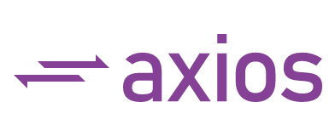
Tech Stack

Slide 11
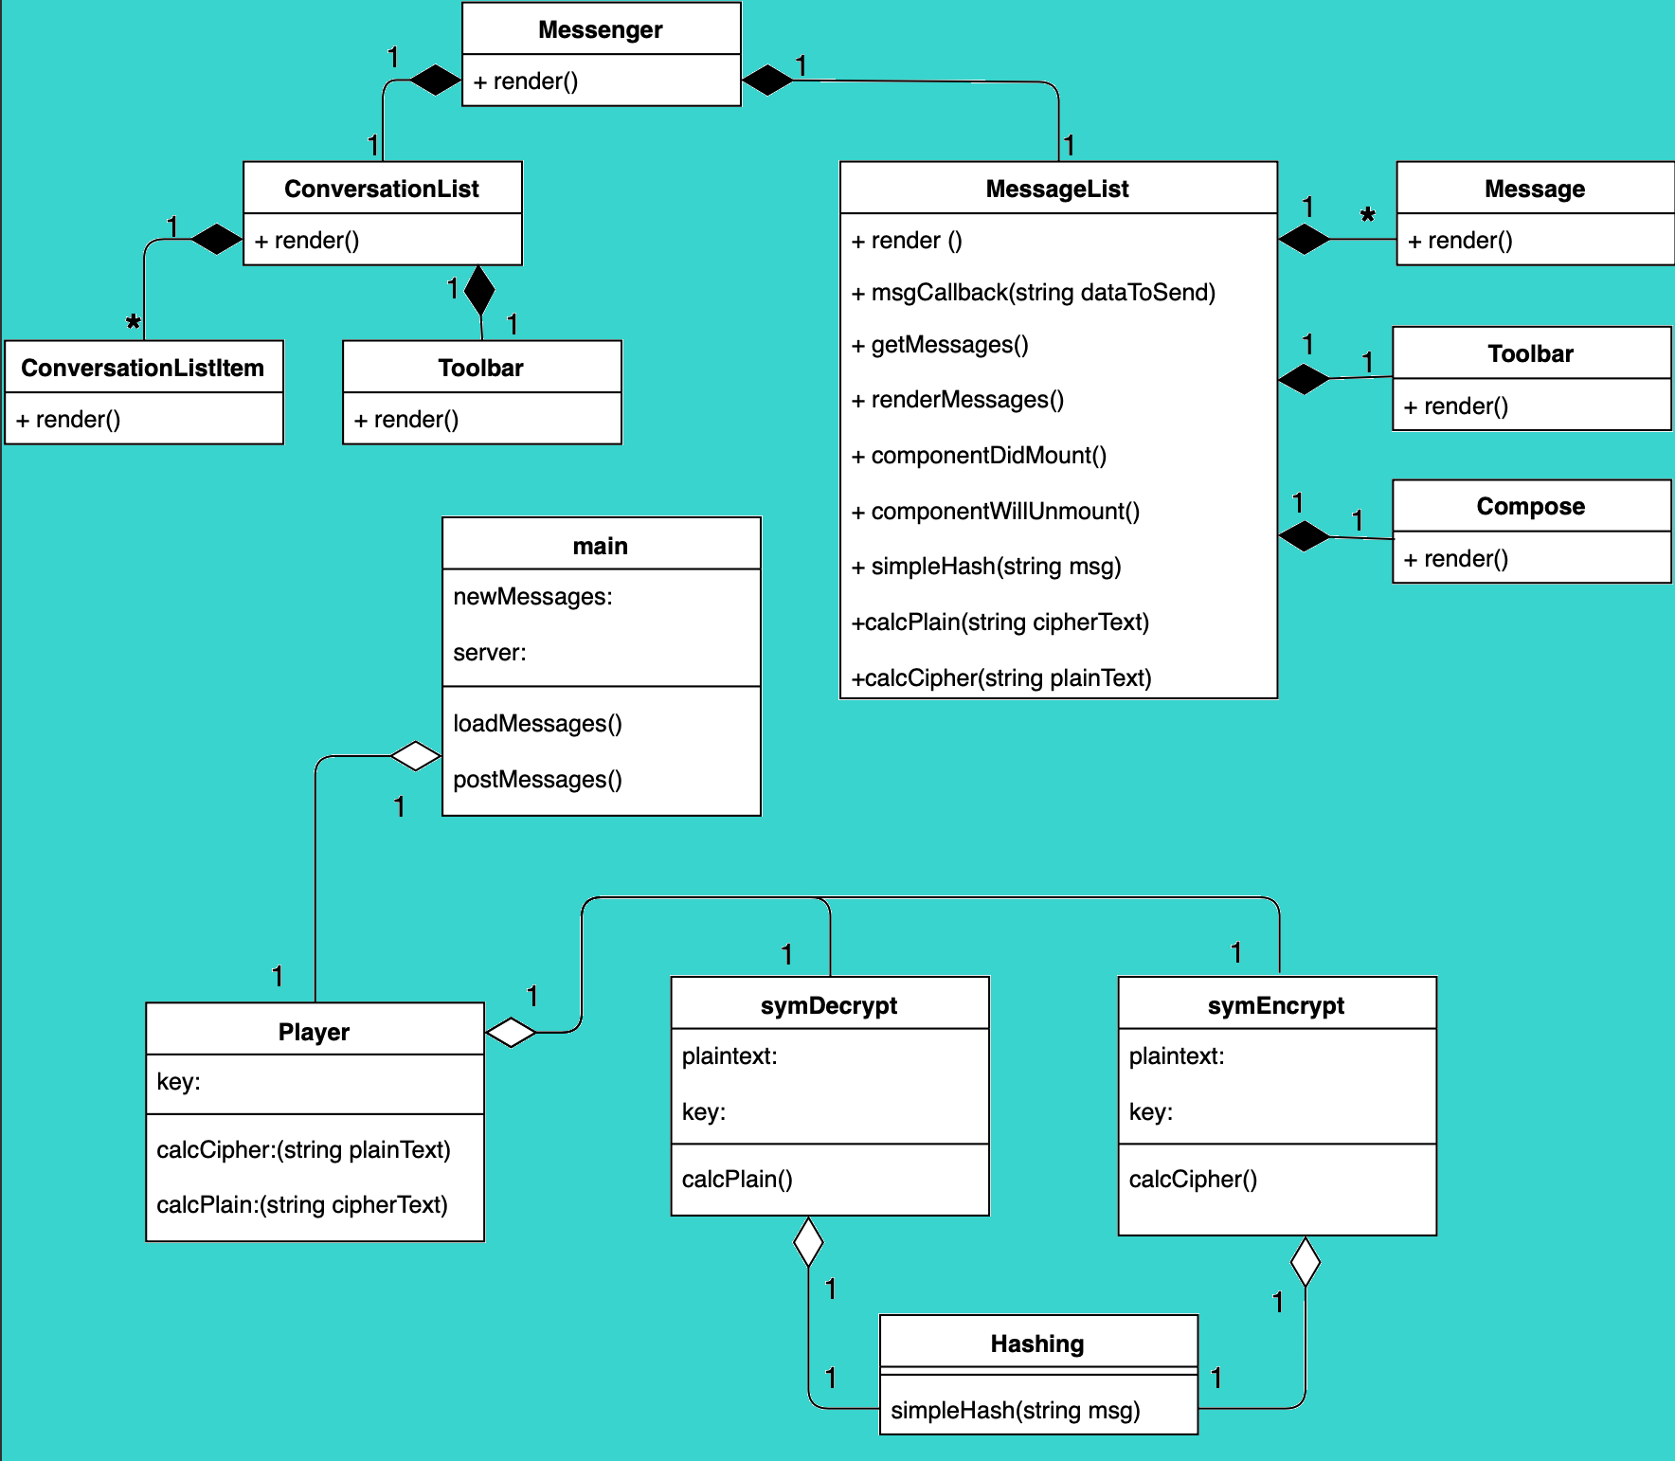
Encrypt-o-File
Class Diagram

Slide 12
Hashing
Hashing is a one-way function used to verify data integrity
A hash of the data is computed before encryption and after decryption
The resulting hashes are compared to ensure that the message has not been altered during transit
Some examples of secure hashing algorithms include SHA-256 and MD5
We used a modified version of a hashing algorithm designed for strings

Slide 13
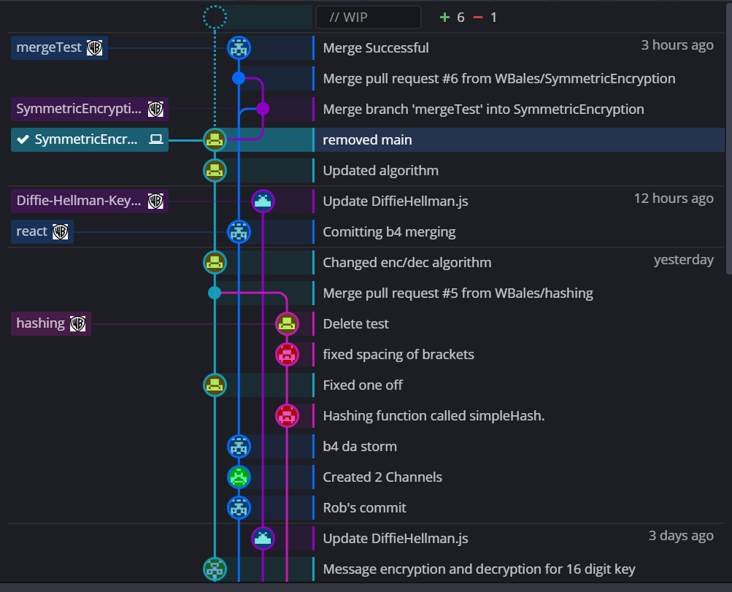
Merging Road Map
Via Github
Illustration of our progress and integrations of the following aspects of the project:
Frontend
Backend (Encryption & Decryption)
Backend (Hashing)
Networking Calls (Axios)

Slide 14
Results
Created a fully functional messaging app
Symmetric encryption was successfully implemented into the app
App has the capability of displaying plain-text or a view of the encrypted data
Unsuccessful in asymmetric encryption and the Diffie-Hellman key exchange

Slide 15
Security Principles & Comparisons

Slide 16
Security Principles
Confidentiality: The data is encrypted, symmetric key is only known by the sender and receiver. Messages stay private
Integrity: The hashing of data assures the data will not be altered in transit
Availability: The system and data are accessible to the users

Slide 17
Comparisons
Kissapp (iOS) [1]
Apple CryptoKit (iPhone 5) [2]
Messenger (USA, Sweden, Ireland) [3]
Riot (Decentralized platform) [3]
Signal (USA only) [3]
Skype (USA, China, Ireland, Japan, Australia, and Netherlands [3]
Threema (Switzerland) [3]
Whatsapp (USA, Spain, Mexico, Brazil, China, India, Turkey) [3]

Slide 18
Conclusion & Future Works

Slide 19
Conclusion
We were able to reach our goals for implementation:
Able to successfully implement a basic messaging app using symmetric encryption
Application upholds confidentiality and integrity principles through symmetric encryption
Created unique implementation through combination of React and Node JS for frontend/backend functionalities

Slide 20
Future Works
Could extend project further through utilizing open-source cryptography libraries
Features we would use:
More robust encryption/decryption library
More complex hashing library
Feature Advantages:
Enhances confidentiality and integrity aspects of the application
Would be a tremendous boost to overall security of the application

Slide 21
References
[1] Kisapp, world's first smart ephemeral and encrypted instant messenger, available on iPhone
and iPad. [Online]. Available: https://www.kisapp.co/en/blog.html. [Accessed:
15-Nov-2019].
[2] “Apple CryptoKit,” Apple CryptoKit | Apple Developer Documentation. [Online]. Available:
https://developer.apple.com/documentation/cryptokit. [Accessed: 15-Nov-2019].
[3] Postfix TLS Support. [Online]. Available:
http://ftp.uma.es/mirror/postfix/doc/TLS_README.html. [Accessed: 16-Nov-2019].

Slide 22
Thank you!
Any Questions?

Slide 23
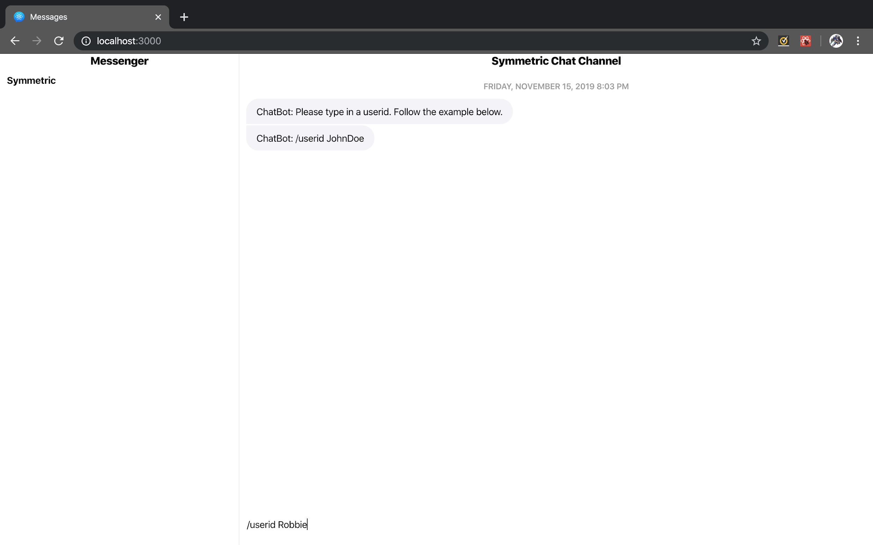
Demo: Enter User Name

Slide 24
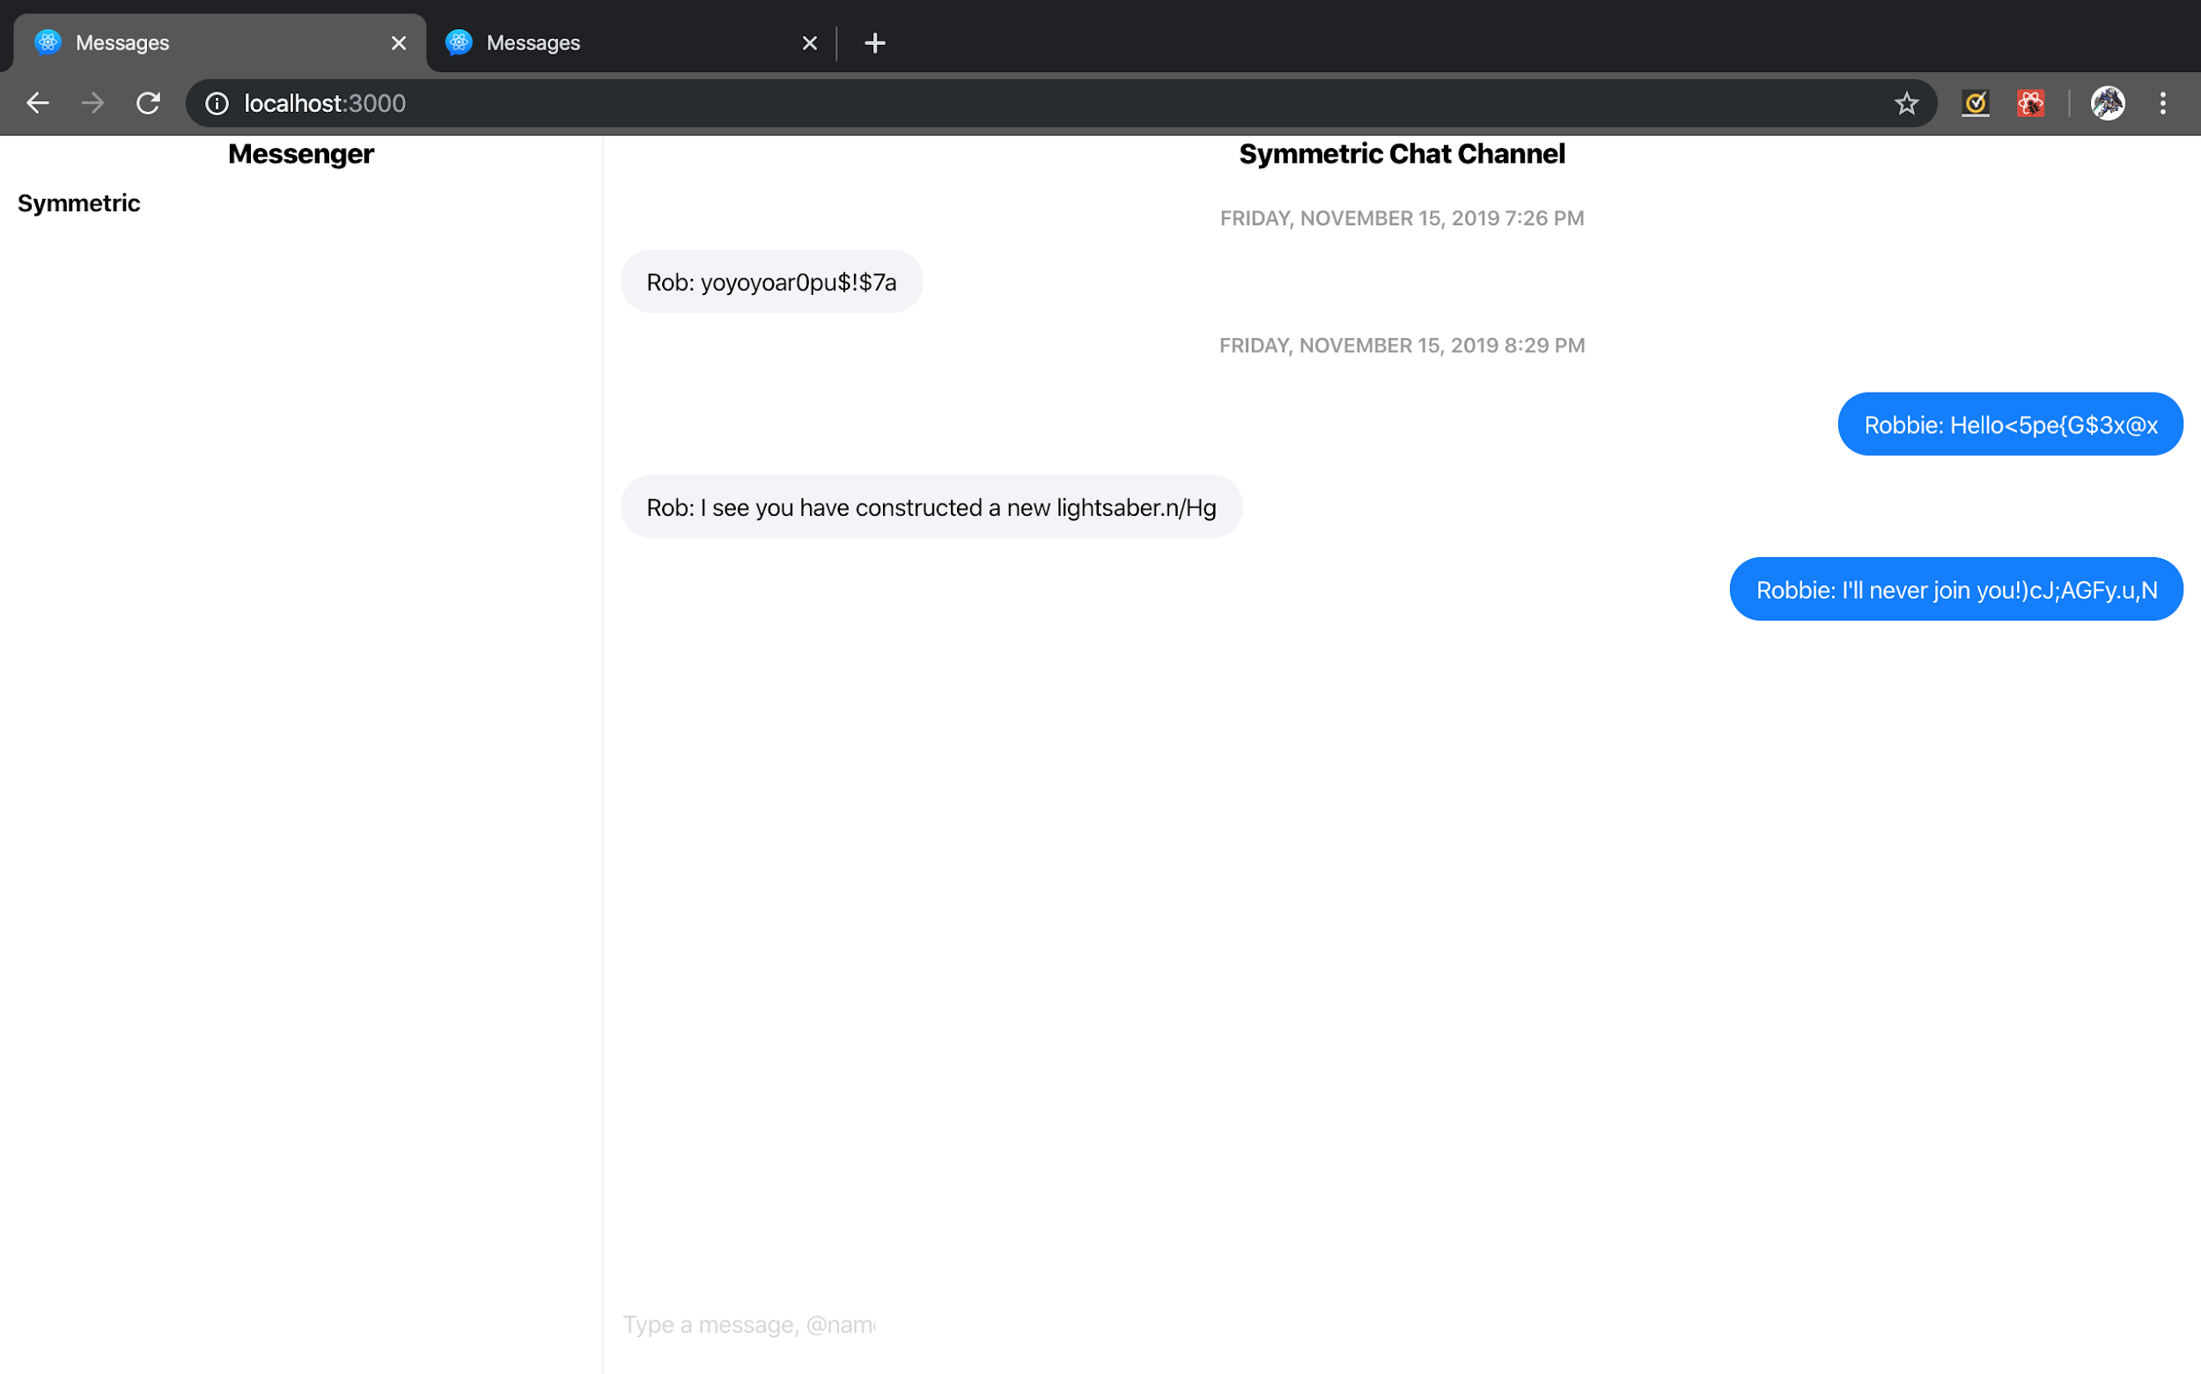
Demo: Chat Room

Slide 25
Demo: Encryption/Decryption
[ ...
{ id: 3,
author: 'Rob',
message: 'I see you have constructed a new lightsaber.n/Hg',
timestamp: 1573871390207 },
{ id: 4,
author: 'Robbie',
message: 'I'll never join you!)cJ;AGFy.u,N',
timestamp: 1573871419769 } ]
[ ...
{ id: 3,
author: 'Rob',
message: 'X>Boy4RC&/rz@tHm~.B~(+<Hts*zH}/#/,8q|*L5qt|G8>pq@NcCILkdHD@N_C_<',
timestamp: 1573871390207 },
{ id: 4,
author: 'Robbie',
message: 'XE;v4$>Jt#*%9x8**/D+=w#mPVP4V&TX@Pe<MFjk@@;Q\\B`>',
timestamp: 1573871419769 } ]

